Slide 1
Visualization

Slide 2
Agenda
QuickSight Introduction
QuickSight Visualization
Big Data Visualization
Microstrategy

Slide 3
QuickSight Introduction
Amazon QuickSight is a cloud-scale visualization tool that is used to deliver easy to understand insights to the stakeholders.
It links to users data in the cloud and combines data from many different sources.
It allows decision-makers to study and comprehend data in an interactive visual environment.
As a cloud based solution, it provides worldwide availability, built-in redundancy and a high level of security.
QuickSight can combine AWS data, third-party data, big data, spreadsheet data, SaaS data, B2B data, and more into a unified data dashboard.
Notes:
Reference for contents : https://docs.aws.amazon.com/quicksight/latest/user/welcome.html

Slide 4
Why Use QuickSight?
Cost of ownership is minimal without any upfront license fees.
SPICE, the memory engine has a high speed of response.
Analysis can be performed on a variety of data.
Results of the analysis are published on an interactive dashboard which has control features.
There's no need to worry about granular database rights because dashboard visitors can only see what you share.
Notes:
Reference for contents : https://docs.aws.amazon.com/quicksight/latest/user/welcome.html

Slide 5
Why Use QuickSight? (Contd.)
Automated and customizable data insights which not only saves time and money but also enables an organization to perform various analysis tasks without any knowledge of machine learning.
Provides enterprise-layer of security including row level security, granular permissions for AWS data access and highly secure data encryption to name a few.
Allows users to write dashboard templates programmatically and transfer them to different AWS accounts.
Simplifies access management by making shared and personal folders for analytical assets.
Notes:
Reference for contents : https://docs.aws.amazon.com/quicksight/latest/user/welcome.html

Slide 6
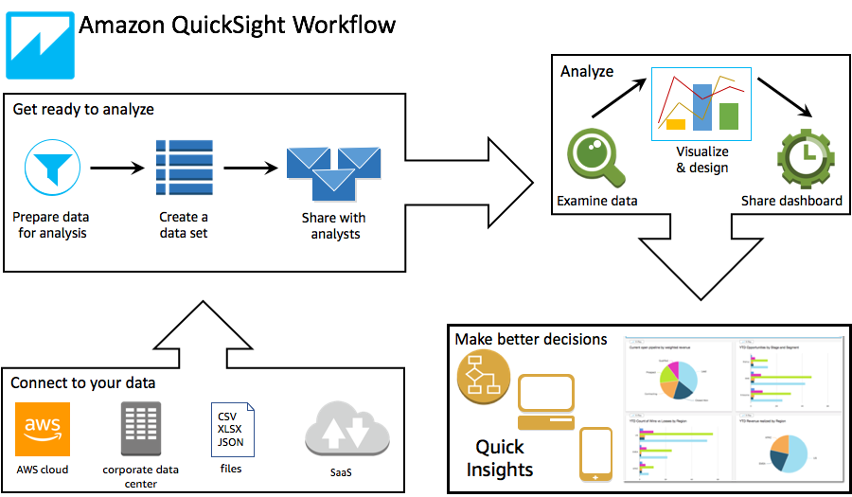
How it Works?
Create a new analysis
Add new or existing datasets
To make the first chart, select fields. Quicksight will propose the optimal visualization.
Add more charts, tables or insights to the analysis. Resize and arrange them on a single or several sheets. Using the extended features, you can add Variables, custom controls, colors, new pages (called sheets), and other features.
Create a dashboard to share the results of the analysis.
Credit: https://docs.aws.amazon.com/quicksight/latest/user/how-quicksight-works.html
Notes:
Reference for contents : https://docs.aws.amazon.com/quicksight/latest/user/how-quicksight-works.html

Slide 7
Connecting to data in Amazon QuickSight
It is the first step in visualization of data in Amazon QuickSight. It basically means to import data to create datasets from a variety of data sources.
These data sources can be from relational data stores, file data stores, JSON data or SaaS data.
QuickSight currently supports the following data types : text and string data, numeric data, Boolean data and date and time data.
After adding the dataset to QuickSight, SPICE, the memory engine specifies a certain quota for data ingestion. There are a maximum of 2,000 columns per file. The name of each column can contain up to 127 Unicode characters and field can have up to 2,047 Unicode characters.
Notes:
Reference for contents : https://docs.aws.amazon.com/quicksight/latest/user/working-with-data.html
https://docs.aws.amazon.com/quicksight/latest/user/supported-data-sources.html
https://docs.aws.amazon.com/quicksight/latest/user/data-source-limits.html
https://docs.aws.amazon.com/quicksight/latest/user/supported-data-types-and-values.html
Extra –
The following are the SPICE quotas:
Each field has 2,047 Unicode characters.
Each column name has 127 Unicode characters.
Each file has 2,000 columns.
Each manifest has 1,000 files.
Each dataset has a maximum of 25 million (25,000,000) rows or 25 GB in the Standard edition.
Each dataset must have 500 million (500,000,000) rows or 500 GB in the Enterprise edition.

Slide 8
Supported Data Sources – Relational Data Stores
Amazon Athena
Amazon Aurora
Amazon Redshift
Amazon S3
MariaDB 10.0 or later
Presto 0.167 or later
Snowflake
Timestream
Microsoft SQL Server 2012 or later
Oracle 12c or later
MySQL 5.1 OR later
Teradata 14.0 or later
Notes:
Reference for contents - https://docs.aws.amazon.com/quicksight/latest/user/supported-data-sources.html

Slide 9
Supported Data Sources – File Data and JSON Data
File data source:
CSV AND TSV – Comma limited and Tab-limited text files.
ELF and CLF - Extended and common log format files.
XLSX - Microsoft Excel files
JSON Data File:
JSON records with structures
JSON records with root elements as arrays
Notes:
Reference for contents - https://docs.aws.amazon.com/quicksight/latest/user/supported-data-sources.html

Slide 10
Supported Data Sources – SaaS Data Sources
Direct connection is supported by the following SaaS sources:
Jira
ServiceNow
OAuth-enabled SaaS sources require you to authorise the connection on the SaaS website. QuickSight must be able to connect to the SaaS data source across the network for this to work. The following are some of these sources:
Adobe Analytics
Github
Salesforce
Twitter
Notes:
Reference for contents : https://docs.aws.amazon.com/quicksight/latest/user/supported-data-sources.html

Slide 11
Creating Datasets from Data Sources
For Microsoft excel or csv files, we can simply upload the file from the local machine.
For Amazon Athena, all Athena databases associated with AWS account are retrieved with no other requirements.
For Salesforce, login credentials are required to connect with the data.
For Amazon S3, we need to provide a manifest indicating the files or buckets we wish to use as well as the target file import settings.
For Amazon Redshift, Amazon RDS, Amazon EC2, or other database data sources, we need to specify the host and database information where the data resides along with the credentials.
Notes:
Reference for contents : https://docs.aws.amazon.com/quicksight/latest/user/creating-data-sets-new.html

Slide 12
Creating Datasets from Relational Data Sources - Athena
Start by creating a new dataset. Choose Datasets from the left-hand navigation window, then New dataset.
For existing Athena datasets (common), select FROM EXISTING DATA SOURCES section from the list of options and choose the card with the existing data source you want to use.
For creating new Athena datasets (less common), follow the steps below:
Select the Athena data source card in the FROM NEW DATA SOURCES section.
For Data source name, enter a name.
For Athena workgroup, choose your workgroup.
To test the connection, select Validate connection.
Select Create Data Source.
Notes:
Reference for contents : https://docs.aws.amazon.com/quicksight/latest/user/create-a-data-set-athena.html

Slide 13
Creating Datasets from Relational Data Sources – Athena (Contd)
4. On the Choose your table screen, follow the steps mentioned below:
For Catalog, opt one of the following:
Choose the catalog you wish to use if using Athena Federated Query.
If not, choose AwsDataCatalog.
Select one of the following:
Select Use custom SQL to create a SQL query.
To select a database and table, go to the Catalog menu and select the catalogue that contains your databases. Then, from the dropdown under Database, select a database and a table from the Tables list that appears for that database.
5. Choose Edit/Preview data.
6. Create a dataset and analyze the data from the table to selecting Visualize.
Notes:
Reference for contents : https://docs.aws.amazon.com/quicksight/latest/user/create-a-data-set-athena.html

Slide 14
Creating Datasets from Text Files
Check data source quotas and supported file types to check compatibility of file with Amazon QuickSight
Choose Datasets from the Amazon QuickSight start page.
Select New dataset from the Datasets page.
Choose Upload a file from the FROM NEW DATA SOURCES section of the Create a Data Set page.
Locate the file from the dialog box and select and open it.
Select Edit/Preview data to prepare the data before creating the dataset. Choose Visualize if you want to create an analysis with the data without any changes.
Notes:
Reference for contents : https://docs.aws.amazon.com/quicksight/latest/user/create-a-data-set-excel.html

Slide 15
Creating Datasets from SaaS Data Sources - Salesforce
Check data source quotas to check compatibility of file with Amazon QuickSight
Choose Datasets from the Amazon QuickSight start page.
Select New dataset from the Datasets page.
Choose the Salesforce icon from the FROM NEW DATA SOURCES section of the Create a Data Set page.
Name the new data source and then select Create data source.
Notes:
Reference for contents : https://docs.aws.amazon.com/quicksight/latest/user/create-a-data-set-salesforce.html

Slide 16
Creating Datasets from SaaS Data Sources – Salesforce (Contd.)
6. Enter your login credentials on Salesforce login page.
7. Choose Select, then REPORT or OBJECT from the Data elements: contain your data drop-down menu.
8. Choose Edit/Preview data to edit the dataset for analysis otherwise, choose a report or object and then Select.
9. Choose Visualize to analyze the data as it is otherwise choose Edit/Preview data to prepare it for analysis.
Notes:
Reference for contents : https://docs.aws.amazon.com/quicksight/latest/user/create-a-data-set-salesforce.html

Slide 17
Preparing datasets for Analysis
Preparation of data simply refers to any changes that you want to make in the dataset before you start analyzing and visualizing it.
It includes steps such as describing data, choosing file upload settings, filtering data, joining data of two or more tables and adding calculations to name a few.
Preparation of dataset can also be done before adding it into the QuickSight, this prepared dataset can be visualized directly without any need for preparation on QuickSight.
You can also use SQL to customize your data according to your needs.
Notes:
Reference for contents : https://docs.aws.amazon.com/quicksight/latest/user/preparing-data.html

Slide 18
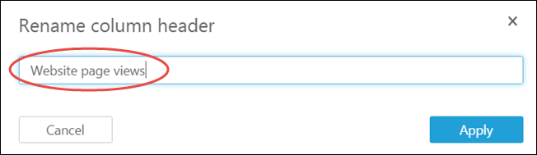
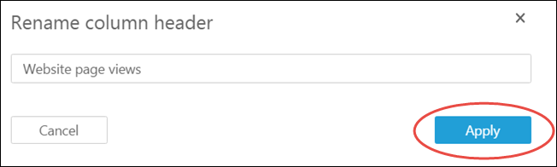
Preparing datasets for Analysis - Examples
Changing field names and description
Select the edit icon on the field you wish to update in the data preview pane.
Make a new name for the field by highlighting it and typing it in.
Choose Apply
Credit: https://docs.aws.amazon.com/quicksight/latest/user/changing-a-field-name.html
Notes:
Reference for contents : https://docs.aws.amazon.com/quicksight/latest/user/changing-a-field-name.html

Slide 19
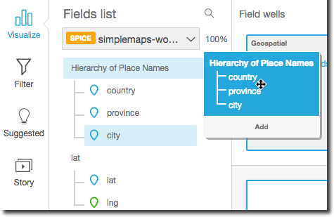
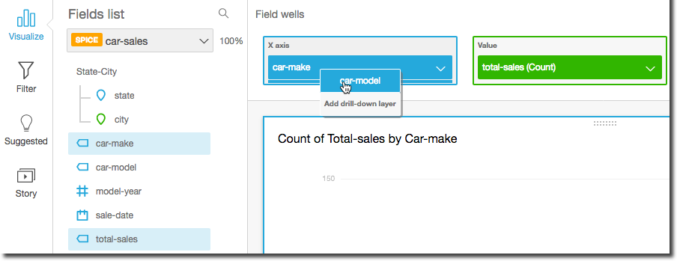
Preparing datasets for Analysis - Examples
Adding a drill down to a data field
On the analysis page, select the charts or graphs that you want to add a drill down.
Click anywhere on the Field Wells to see the expanded hierarchy.
If the dataset has a proper hierarchy, stop at this step otherwise, add a hierarchy for your analysis
Credit: https://docs.aws.amazon.com/quicksight/latest/user/adding-drill-downs.html
Notes:
Reference for contents : https://docs.aws.amazon.com/quicksight/latest/user/adding-drill-downs.html

Slide 20
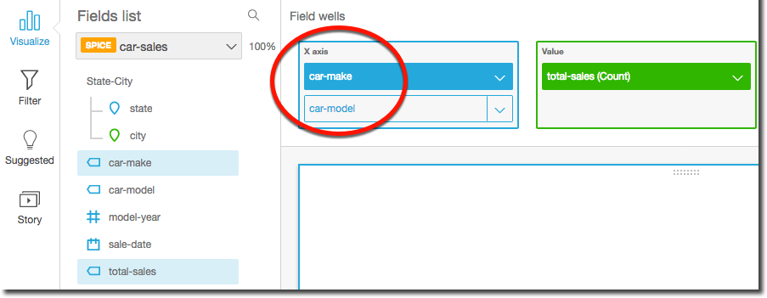
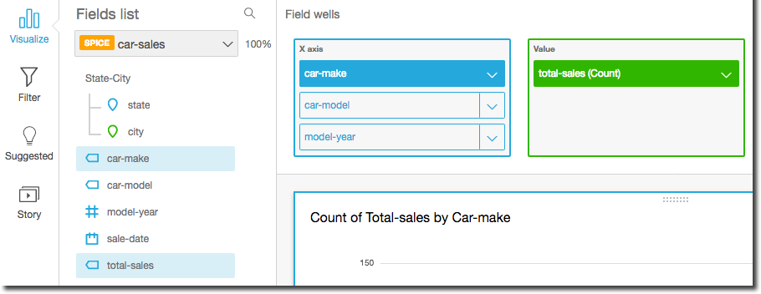
Preparing datasets for Analysis - Examples
Adding a drill down to a data field
Drag a field that you wish to see in your hierarchy at the exact position you want to see it in the hierarchy. The label for the new drill down field should be Add drill-down layer.
Keep repeating the above steps until you have added all the drill-downs to your visual.
To see the results of drill-sown on the visual, select a line or a bar chart and choose Drill down to <lower level> or Drill up to <higher level>
Credit:https://docs.aws.amazon.com/quicksight/latest/user/adding-drill-downs.html
Notes:
Reference for contents : https://docs.aws.amazon.com/quicksight/latest/user/adding-drill-downs.html

Slide 21
Preparing datasets for Analysis - Examples
Describing the dataset – Editing a description of a column
On the QuickSight start page, select the dataset that you want to work with.
After this, choose a column you want to edit the description of.
To edit the description, choose one of the following :
Edit the description in the settings for the field from the pencil icon next to it.
Open the settings from menu next to th.e field name, then select the option Edit name & description
Edit the description with the way you want.
Choose Apply to the make the changes effective.
Notes:
Reference for contents : https://docs.aws.amazon.com/quicksight/latest/user/describing-data.html

Slide 22
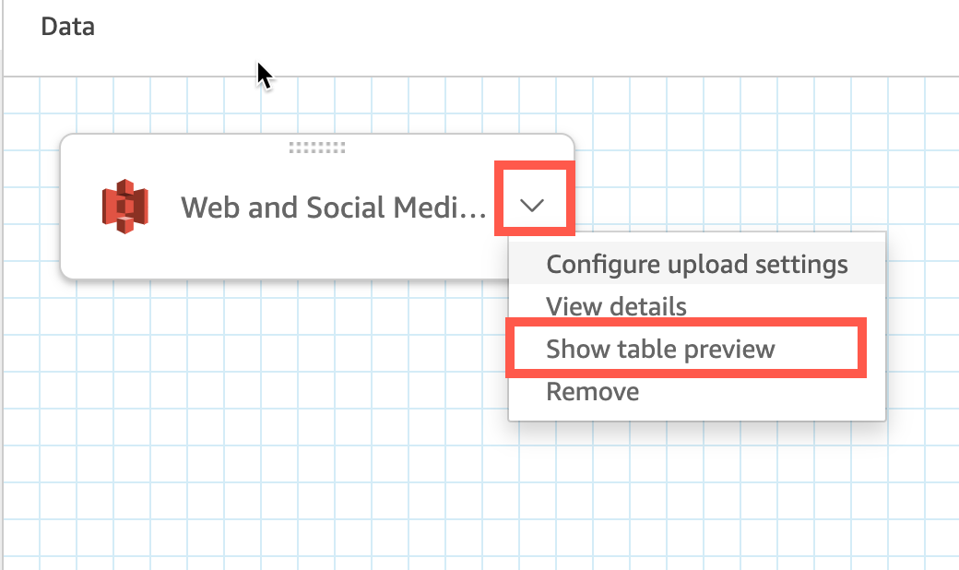
Preparing datasets for Analysis - Examples
Previewing a dataset
Choose Datasets that you want to preview on the start page.
Select Edit dataset option from the menu.
Select the table you want to preview, then click on the down arrow and select Show table preview
Credit:https://docs.aws.amazon.com/quicksight/latest/user/previewing-tables-in-a-dataset.html
Notes:
Reference for contents : https://docs.aws.amazon.com/quicksight/latest/user/previewing-tables-in-a-dataset.html

Slide 23
Visualizing the data in Amazon QuickSight
After the addition and preparation of data, the next step is to analyze and visualize the data.
The results of these analyses are then published on a dashboard which is used by the organization to better understand the data.
Amazon QuickSight enables users to perform multiple analyses, create visuals of these analyses and display all these analyses on a single page called as ‘sheets’.
QuickSight gives us the option to illustrate our findings with the help of a variety of visuals from charts, graphs to histograms and maps each intended to serve an intended purpose.
Since it has an automated visualization tool, QuickSight makes it very easy to perform visualization operations on any feature of big data.
Notes:
Reference for contents : https://docs.aws.amazon.com/quicksight/latest/user/working-with-visuals.html

Slide 24
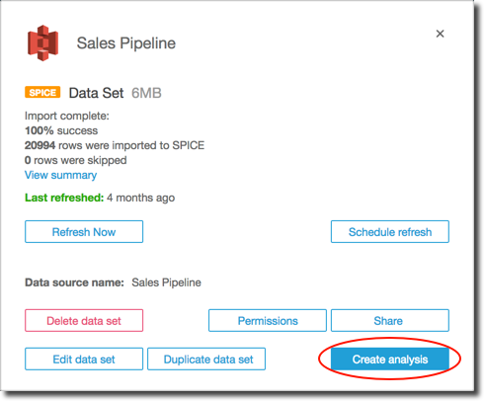
Creating a New Analysis on QuickSight
On the QuickSight start page, click on the All analyses tab then choose New analysis.
It will take you into the Datasets page, choose the dataset of your choice and then select Create analysis.
Create a visual which corresponds to the data you want to display.
To edit an analysis, you can perform a set of operations (see next slide).
Credit:https://docs.aws.amazon.com/quicksight/latest/user/creating-an-analysis.html
Notes:
Reference for contents : https://docs.aws.amazon.com/quicksight/latest/user/creating-an-analysis.html

Slide 25
List of Operationss for Editing an Analysis
Editing the description of an analysis.
Renaming an analysis.
Taking a duplicate version of an analysis.
Viewing the details of an analysis.
Keeping track of changes to analyses.
Data extraction from analyses.
Deleting an analysis.
Notes:
Reference for contents - https://docs.aws.amazon.com/quicksight/latest/user/creating-an-analysis.html

Slide 26
What are Sheets?
A sheet is a collection of visuals displayed on a single page. After you make an analysis, you display all the visuals on the single sheet in the workspace.
This is very similar to a newspaper except that its loaded with data visuals.
There can be multiple sheets functioning together or independently in the workspace.
The far left page is the top sheet, often known as the default sheet. In an analysis or dashboard, this sheet appears at the top and up to 20 sheets can be included in each analysis.
Notes:
Reference for contents : https://docs.aws.amazon.com/quicksight/latest/user/working-with-multiple-sheets.html

Slide 27
Types of Visuals Supported in Amazon QuickSight
AutoGraph
Bar Charts
Box Plots
Donut Charts
Funnel Charts
Gauge Charts
Histogram
KPIs
Combo Charts
Pie Charts
Maps and Geospatial Charts
Sankey Diagrams
Notes:
Reference for contents : https://docs.aws.amazon.com/quicksight/latest/user/working-with-visual-types.html

Slide 28
Creating a Pie Chart
Choose Visualize from the tool bar on the analysis page.
On the application bar, select Add, and then Add visual.
Select the pie chart icon from the Visual types pane.
Drag the fields you want to use to the appropriate field wells from the Fields list pane. As suggested by the target field well, you should often employ dimension or measure fields.
Drag a dimension to the Group/Color field well to make a pie chart. Drag a measure to the Value field well if desired. Dragging one or more fields to the Group/Color palette will add drill-down layers.
Notes:
Reference for contents : https://docs.aws.amazon.com/quicksight/latest/user/pie-chart.html

Slide 29
Formatting Visuals in QuickSight
Adding a graphic title and subtitle to a video
Creating a custom visual legend
Creating your own visual labels
Visuals with conditional formatting
Changing the font and style
Changing the scale and range of your graphics
Creating custom data labels on visuals
Changing hue on visuals
Creating custom tooltips
When it comes to visuals, you can use conditional formatting to make them look better
Showing Totals and Subtotals.
Notes:
Reference for contents : https://docs.aws.amazon.com/quicksight/latest/user/formatting-a-visual.html

Slide 30
Arranging Visuals in Dashboard
Tiled Layout - In a Tiled layout, the visuals are snapped to a grid with consistent spacing and alignment. Visuals can be any size and placed wherever you wish on a dashboard, but they can't overlap.
Free-form Layout - Visuals with a Free-form layout can be positioned precisely anywhere on your dashboard. You can either drag a visual to the exact location you want it to be, or you can enter the visual's coordinates.
Classic Layout - In a Classic layout, visuals are arranged in a grid with uniform space and alignment. To suit smaller screen sizes, dashboards hide data or change formatting.
Notes:
Reference for contents : https://docs.aws.amazon.com/quicksight/latest/user/types-of-layout.html

Slide 31
How to Make the Dashboard Interactive?
Interactive dashboards give real value to any analyses performed in Amazon QuickSight.
Parameters are used to make the dashboards interactive and easy to understand for the users.
Parameters are variables that can be used to send a value to an action or object. It is easier for a dashboard user to engage with dashboard elements in a less technical way by utilizing parameters.
Parameters can also be used to link one dashboard to another, allowing users to take an in depth look into data from a different analysis.
Parameters can only work when its conjoined or connected to the analysis.
Notes:
Reference for contents : https://docs.aws.amazon.com/quicksight/latest/user/parameters-in-quicksight.html

Slide 32
Big Data Visualization
Big Data Visualization is the process of displaying valuable insights on an interactive dashboard where analysis was performed on a variety of structured, semi-structured and unstructured data.
In Amazon Web Services, Big Data Visualization is performed using the Amazon QuickSight Enterprise Edition Visualization tool.
Amazon QuickSight has machine learning and natural language capabilities embedded in it and users can perform analyses and visualizations without the need to learn any machine learning languages.
Amazon QuickSight saves a lot of time by providing automated visualization tools thereby, eliminating any need of manual analysis.
Notes:
Reference for contents : https://docs.aws.amazon.com/quicksight/latest/user/making-data-driven-decisions-with-ml-in-quicksight.html

Slide 33
Big Data Visualization – Three Major Features by QuickSight
Anomaly Detection – With QuickSight, you can easily find out outliers that are causing any major changes to the data. This is done by QuickSight’s proven ML-powered algorithm. It uses Random Cut Forest algorithm on a large amount of data which makes it efficient to find anomalies rather than going the manual way.
Forecasting – It provides lesser technical users the chance to illustrate their findings without having to know any coding knowledge.
Autonarratives – QuickSight gives the users the option to tell the stories of their analysis in plain language using Autonarratives. It can not only save a lot of time but also it will be simple to understand for all the people in the organization.
Notes:
Reference for contents : https://docs.aws.amazon.com/quicksight/latest/user/making-data-driven-decisions-with-ml-in-quicksight.html

Slide 34
Microstrategy
MicroStrategy (Nasdaq: MSTR) is a prominent provider of enterprise analytics and mobility software and services throughout the world.
The objective of the company is to make every business more intelligent. MicroStrategy provides modern analytics on an open, comprehensive enterprise platform that uses Federated Analytics, Transformational Mobility, and HyperIntelligence to generate business results.
Initially it was traditionally deployed on company premises but due to huge demand of customers to use it, it opted to move its platform to AWS.
With this, the company launched the MicroStrategy Cloud Platform that allows its users to find analytical solutions faster.
Notes:
Reference for contents : https://aws.amazon.com/solutions/case-studies/microstrategy/

Slide 35
Microstrategy
By connecting to AWS, scalability issue was resolved by optimizing the necessary infrastructure needs.
The new platform includes four products namely, Amazon Elastic Compute Cloud, AWS CodeDeploy, Amazon Elastic File System, Amazon Elastic Block Storage.
For speedier data processing, the MicroStrategy Cloud Platform includes a cutting-edge in-memory architecture. It takes advantage of this architecture to dynamically load data into server memory and to use partitioning or parallel processing capabilities to help enterprises analyse millions of rows of data more quickly.
MicroStrategy’s partnership with AWS has enabled installation and configuration with only three links instead of more than 350.
Notes:
Reference for contents : https://aws.amazon.com/solutions/case-studies/microstrategy/

Slide 36
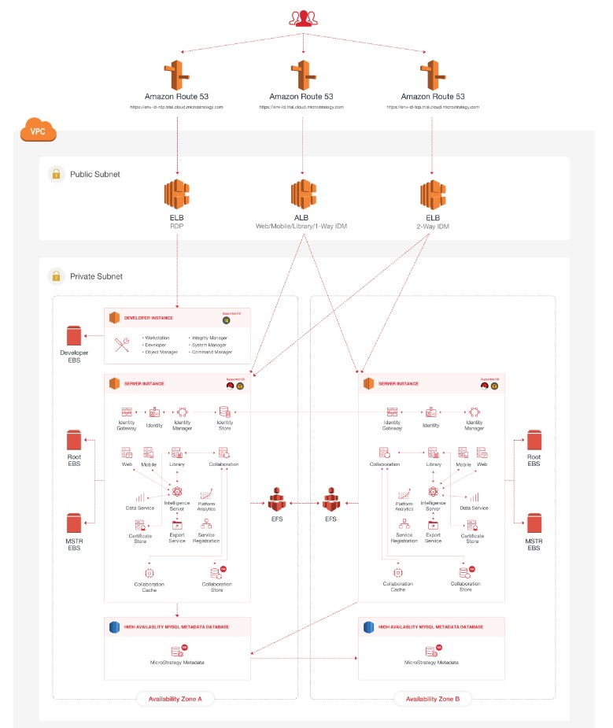
Architecture of Microstrategy
Credit : https://aws.amazon.com/solutions/case-studies/microstrategy/
Notes:
Reference for contents : https://aws.amazon.com/solutions/case-studies/microstrategy/

Slide 37
Real Life Benefits of Microstrategy
Customers may deploy the entire platform in 30 minutes instead of weeks.
Assisting a beverage firm in providing faster data access to salespeople.
Allowing a pharmaceutical company to reach 90% of its field representatives with intelligence.
Providing real-time business KPI updates to help internet marketing companies empower their business leaders.
Notes:
Reference for contents : https://aws.amazon.com/solutions/case-studies/microstrategy/

